Slide 1

N-Link DH Inverse kinematics solver using neural networks
Deac George Antoniu

Slide 2
What is the problem of inverse vs forward kinematics?
Forward kinematics: Where is the end effector of a robot located in space given that we know the angles of the servo motors?
Joint Variables —–> Pose of the End effector of a Robotic Arm = Forward Kinematics
Inverse kinematics: What do the angles of the servo motors need to be, given our desired position and orientation of the end effector of a robotic arm?
Pose of the End effector of a Robotic Arm —–> Joint Variables = Inverse Kinematics

Slide 3
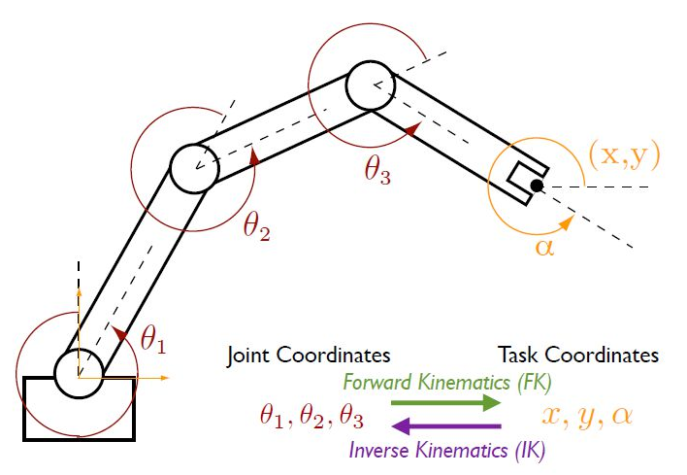
Joint coordinates/ Task coordinates

Slide 4
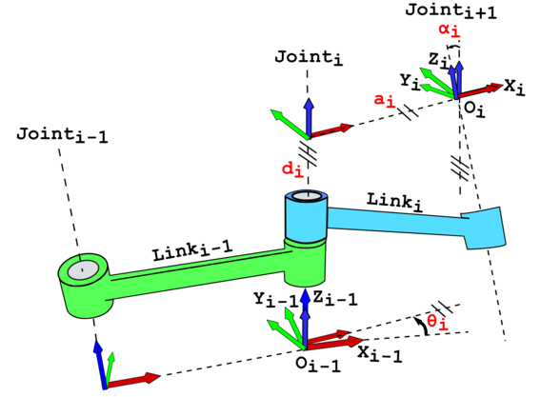
DH parametrization
Denavit-Hartenberg parametrization convention is used for computing the composite homogeneous transformation.
Especially for training, I am strictly using the forward kinematics to produce a set of features (Cartesian position of the end effector) and labels (joint angles).

Slide 5
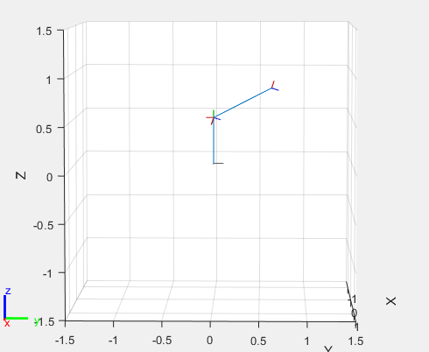
Kinematic model studied
A simple 3R articulated arm was studied due to simplicity, but it is easily extendable to the most common 6R articulated arm

Slide 6
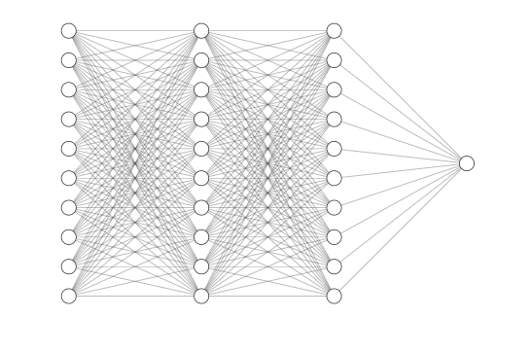
Architecture of the model
I’ve tried multiple configurations of sequential models, also more generally, this was a study of minimizing error using neural networks on arbitrary nonlinear mappings and also to experiment with the most optimal parameters and the most suited activation function
(50, 50, 50, 1) fully connected
Tanh was used as activation
Another use of a significantly different type of activation function having a geometric aspect, such as radial basis functions was studied

Slide 7
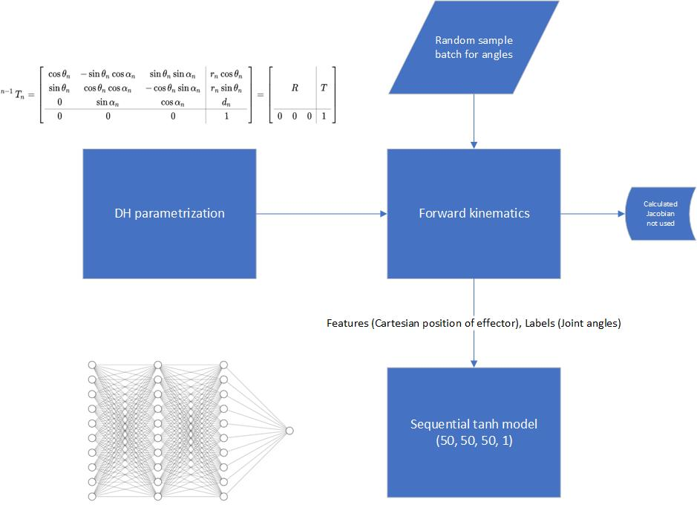

Slide 8
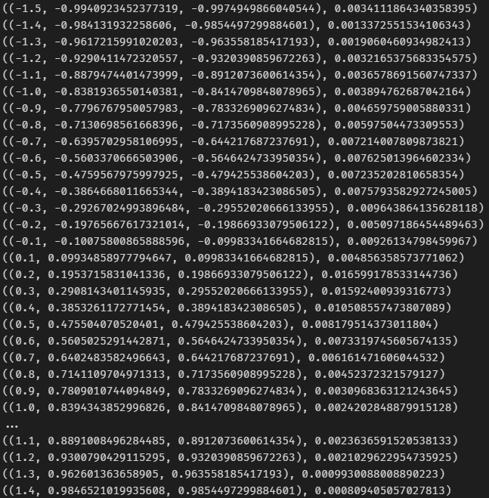
Preliminary results
The best deviation from precision of the forward kinematics provided angles of this model was of 10^-2 radians or 10^-1 degrees which is quite poor in terms of industrial precision
Although as an experiment this pipeline can be extended and as was suggested in the literature the RBF (radial basis function) implementation of activation also needs to be tested

Slide 9
Thank You

